Slide 1

Leveraging Azure Data Factory and Databricks for Insights and Anomaly Detection
Hexaware Data Engineering
Project 2: Log Analysis in Spark

Slide 2

Introduction to Log Analysis
In today's data-driven world, log analysis is crucial for understanding system performance and detecting anomalies. This presentation explores how to enhance log analysis in Spark projects by leveraging Azure Data Factory and Databricks. We will discuss insights and techniques for effective anomaly detection.

Slide 3

Understanding Log Data
Log data contains valuable information about system behavior. It includes event timestamps, error messages, and user interactions. By analyzing this data, organizations can gain insights into performance issues and identify security threats. Effective log analysis is key to maintaining system integrity.

Slide 4


Role of Spark in Log Analysis
Apache Spark provides a powerful framework for processing large volumes of log data. Its in-memory computing capabilities enable fast data processing and analysis. Spark's libraries, such as Spark SQL and MLlib, facilitate advanced analytics and machine learning for anomaly detection.

Slide 5

Project Requirements
Azure Data Factory
Azure Storage Account
Azure Databricks:
Integration Runtime Pipeline
Log Files

Slide 6


Utilizing Databricks for Insights
Step 1 : Data Factory Account Setup → Create Data Factory instance
Step 2 : Storage Account & Container → Create Blob Storage Account → Create Container Step 3 : Azure Databricks Setup → Create Databricks Workspace → Conﬁgure Databricks Cluster
Step 4 : Install Integration Runtime → Install Integration Runtime → Conﬁgure Self-hosted Integration Runtime or Azure Integration Runtime
Step 5 : Data Factory Pipeline Creation → Set Source (Azure Blob Storage) → Set Destination (Azure Databricks)→ Deﬁne Transformations Step 6 : Setup Integration → Conﬁgure Blob Storage Connection → Conﬁgure Databricks Connection
Step 7 : Execute Pipeline → Trigger Pipeline Execution → Monitor Pipeline Execution
Step 8 : Perform ETL in Databricks → Extract data from Blob Storage → Transform data (error rate, trends, anomaly detection) → Load processed data back to Blob Storage
Step 9 : Verify Processed Data → Check Blob Storage for processed data

Slide 7

Anomaly Detection Techniques
Detecting anomalies in log data is vital for preempting issues. Techniques such as statistical analysis, machine learning, and pattern recognition can be employed. By setting thresholds and identifying outliers, organizations can proactively address potential problems before they escalate.

Slide 8
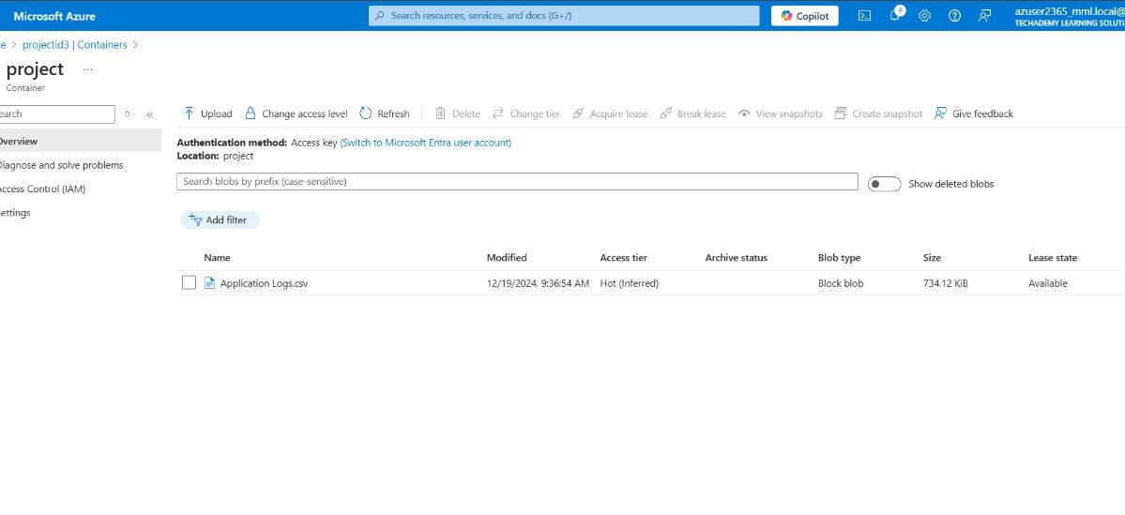
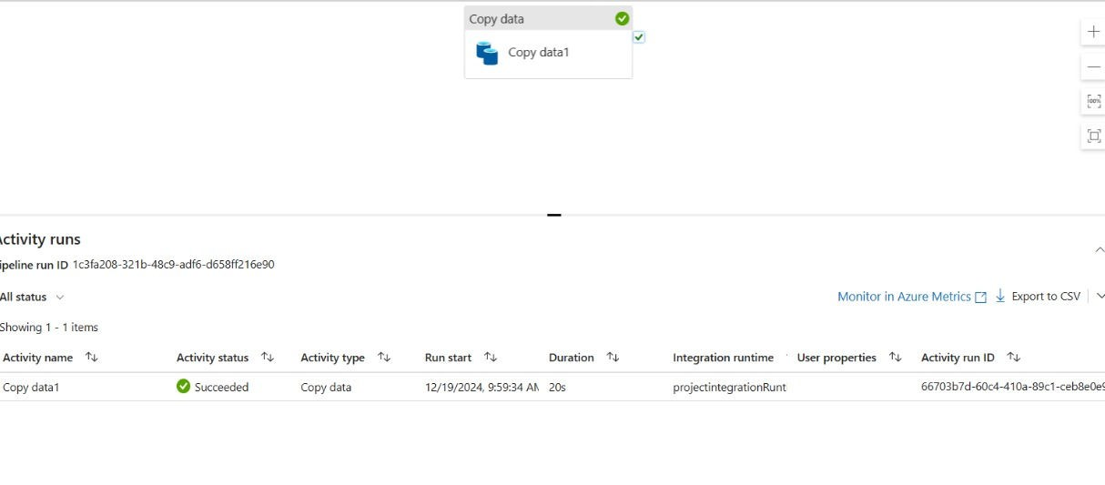
Output Snaps

Slide 9
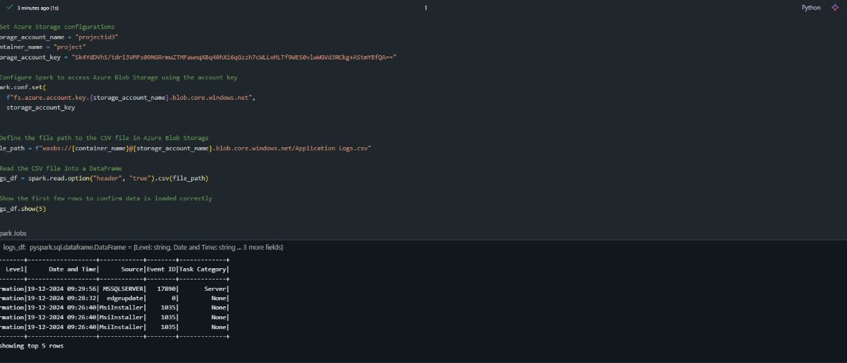
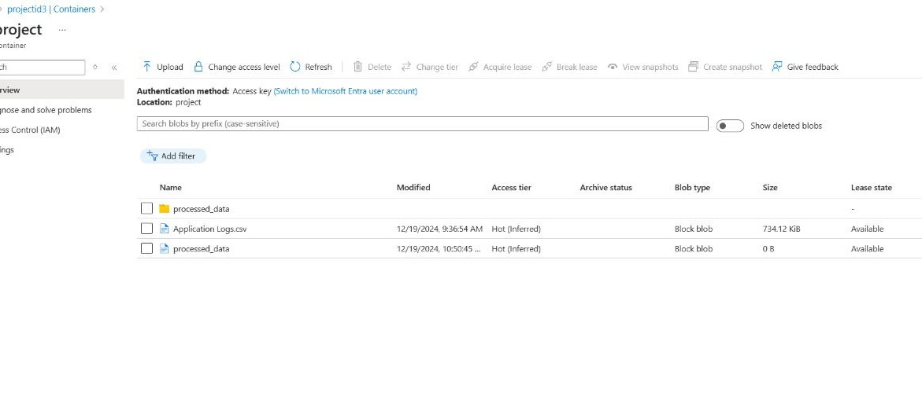
Output Snaps

Slide 10

Conclusion and Future Directions
In conclusion, enhancing log analysis in Spark projects using Azure Data Factory and Databricks is crucial for gaining insights and detecting anomalies.
By adopting these tools and techniques,
organizations can improve their operational efﬁciency and ensure system reliability in the future.

Slide 11

Thanks!
Team Members:
Aniroop Gupta, DE-1 Harish ER, DE-1 Subrat Shukla, DE-1

